Slide 1

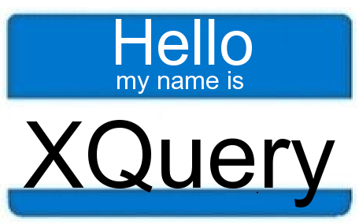

Babel
Frank Roetker, Jordon Phillips, Ricky Shomer

Slide 2
Project Goal
The goal of Babel is to provide a means for querying upon multiple databases.
These databases may be all the same type (i.e. Microsoft SQL) or might be completely different (i.e. XML, Neo4j).

Slide 3
Possible Use Cases
While not all possible use cases have been explored, one possible case would be where one needs to store a set of identical data in each system.
Additionally, it can be used for those who are simply too lazy or do not have enough time to learn a new query language.

Slide 4
Implementation
The first part is, essentially, an API.
It will take in SQL and translate it into equivalent commands for any of the supported databases.
The hope is that other programmers can take the translation tools and use them for other projects.

Slide 5
Implementation (Cont.)
The second part will consist of the front end and the connectivity background.
This will be a GUI tool that will allow users to configure multiple databases to perform queries upon, gathering a combined result set.
Users will be able to select which of the configured databases they wish to perform their queries upon.

Slide 6
Major Tasks
Git Admin
Global Connectivity - establishing connections with the databases, storing configuration
XQuery translate - translating to XQuery
XQuery OPs - performing the operations on XQuery databases
Neo4j translate - translating to Neo4j
Neo4j OPs - performing the operations on Neo4j databases
SQL OPs - performing the operations on TSQL databases
Views - Creating the GUI
Gathering - magically combining the result sets

Slide 7
Timeline Proposal
Week | Starting Tasks | Ending Tasks | Notes
4 | Global Connectivity, Git SetUp |  | There is no way Jordon can mess this up, but if he does then we will disown him.
5 | XQuery OPs, Neo4j OPs, SQL OPs | Global Connectivity | Start to learn Neo4j. Use premade queries at this point.
6 | XQuery translate, Neo4j translate | XQuery OPs, Neo4j OPs, SQL OPs
7 | Gathering, Views
8 |  | Gathering
9 |  | XQuery translate, Neo4j translate, Views
10 |  | Last minute changes | Presentation, Final Report, Full Documentation on Github

